Slide 1
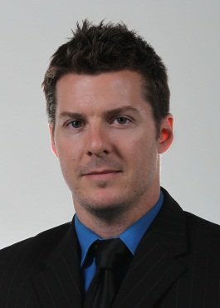
London Knights
Instructors
ROB SIMPSON, Assistant General Manager/Assistant Coach
Rob enters his 3rd season as Assistant General Manager/Assistant Coach with the London Knights. A Cobourg, Ontario native, Rob played Tier II Junior A hockey for his hometown team the Cobourg Cougars. He has coached at the AAA Minor Midget level for both the Elgin Middlesex Chiefs and the London Junior Knights, winning Alliance Championships with both organizations. He has represented the Alliance at the OHL Cup with the 2010 Elgin Middlesex Chiefs (a team that featured current London Knights Matt and Ryan Rupert) and the 2012 London Jr. Knights. His 2012 London Jr. Knights team went 64-10-4 overall for the year and a impressive 11-0-1 en-route to the Alliance Championship. During his time coaching minor hockey, he has had 25 players from his team selected in the OHL priority draft over the past 4 years. Most notably 1st round NHL Draft selection Jared McCann. He also spent the 2011-2012 season scouting for the OHL Central Scouting program covering Western Ontario and the Alliance Hockey League.
While juggling both roles is a large job, Rob welcomes the challenge. As the Assistant GM, Rob is responsible for the day to day operations of the team and ensures that everything is running smoothly so that he can help to eliminate any distractions for the players. Rob looks after all OHL contracts, organizing the main/mini training camp, arranging and overseeing all billeting, team travel, scouting, immigration & IIHF/USA transfers, player’s schooling, trades, OHL Priority Selection and CHL Import Draft, player relations and media relations. In his role as Assistant Coach, Rob is responsible for assisting Head Coach Dale Hunter and the London Knights coaching staff with all aspects of on and off-ice development of the London Knights players. This includes but is not limited to; working with the forwards, the development of the young draft picks and prospects within the system, skills/player development, video pre-scout and analysis, practice planning, and game strategy.

Slide 2
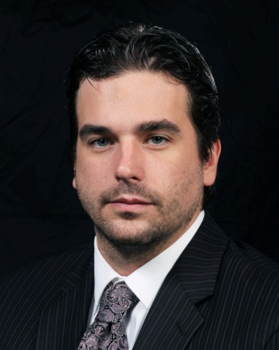
London Knights
Instructors
DYLAN HUNTER, Assistant Coach
Dylan Hunter is entering his 4th year as an Assistant Coach with the London Knights. Prior to joining the Knights coaching staff, Dylan played five years of professional hockey in the AHL and ECHL being drafted in the 9th round (273rd overall) of the 2004 NHL Entry Draft by the Buffalo Sabres. During his time as a professional – Dylan played over 300 games collecting 60 goals, 115 assists and 175 points to go along with 225 PIM.
Prior to his career as a professional, Dylan was a member of the London Knights from 2001-2006 where he played in 315 games. During his time as a Knight, Dylan scored 106 goals, 263 assists totalling 369 points to go along with 240 PIM. Additionally, Dylan was instrumental in the team’s 2005 Memorial Cup Championship and was appointed status of Captain for the London Knights during the 2005/2006 season. In his role as Assistant Coach, Dylan is responsible for assisting Head Coach Dale Hunter and the London Knights coaching staff with all aspects of on and off-ice development of the London Knights players. This includes but is not limited to; working with the Defense, the development of the young draft picks and prospects within the system, skills/player development, video pre-scout and analysis, practice planning, and game strategy.
Career Highlights:
- Member of Team Ontario in the World Under-17 Championships in Selkirk, Manitoba
- Member of the Canada/Russia Challenge Series in November 2004
- Member of the Memorial Cup Champion London Knights (2005)
- Became Knights franchise leader in games played on December 2, 2005 (275 GP)
- Captain of the London Knights (2005/2006 season)
- With Rob Schremp and David Bolland, Hunter was one-third of one of the most productive lines in the Canadian Hockey League during the 2005/2006 season
- Named American Hockey League Player of the Week for the week ending November 5, 2007
Misha S. Donskov
The University of Western Ontario
Graduate School of Kinesiology
KIN 9630: Art & Science of Coaching
Dr. Bob La Rose

Slide 3
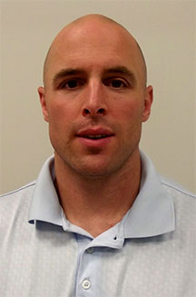
London Knights
Instructors
DWAYNE BLAIS, Power Skating Coach
Director of Hockey Operations for Total Package Hockey Canada. Dwayne currently works with NHL players and prospects, Major Junior players, NCAA division I players, as well as young players in Southwestern Ontario.
Dwayne brings over 20 years of professional power skating and skill development experience and has created curriculum for a variety of skill development programs that currently run in Canada and the US. His knowledge and understanding of the skills necessary to play at the next level allows players to develop under professional coaching by learning and mastering fundamentals and developing high level skills.
Dwayne had the opportunity to work along side Martin Gelinas in 2010 and 2011 as the Power Skating/Skills Coach for the Nashville Predators Prospect Camp.
Dwayne previously coached in the Quebec Major Junior Hockey League with the Saint John Seadogs (2006-07) and was also an assistant coach for the Western Mustangs Men's hockey team (2005-06 and 2007-09).
Over the past 3 years Dwayne has had the opportunity to help players achieve their goal of being drafted to the OHL, 2012 Jared McCann (4th Overall to Sault St Marie), 2013 Travis Konecny 1st Overall (Ottawa 67's), Lawson Crouse 5th Overall (Kingston Frontenac's), Mitch Van de Sompel 14th Overall (Oshawa Generals).
Dwayne played 3 years of professional hockey in the East Coast Hockey League. Prior to playing professionally, Dwayne played 4 years of NCAA Division I college hockey for the University of Alabama Huntsville Chargers where he captained his team in his senior year and won the CHA scoring title in back to back seasons.
Misha S. Donskov
The University of Western Ontario
Graduate School of Kinesiology
KIN 9630: Art & Science of Coaching
Dr. Bob La Rose

Slide 4
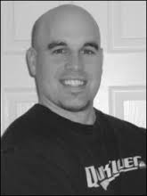
London Knights
Instructors
CORY CAMPBELL, Goalie Coach
Professional
Los Angeles Kings 3rd Round Draft Pick
ECHL All Star
UHL Champion With Fort Wayne Komets
Major Junior
OHL Champion With Belleville Bulls (OHL)
Memorial Cup Top Goaltender With Belleville Bulls (OHL)
Windsor Spitfire Regular Season & Playoff MVP (OHL)
OHL All Rookie Team
Coaching / Strength & Conditioning
Certified Strength & Conditioning Coach for 8 Years
Have Worked With Numerous Players & Goalies Now Playing Professional, NCAA & Major Junior
Former Goalie Coach of Stratford Cullitons
Huron Perth Laker Goalie Consultant
Misha S. Donskov
The University of Western Ontario
Graduate School of Kinesiology
KIN 9630: Art & Science of Coaching
Dr. Bob La Rose

Slide 5
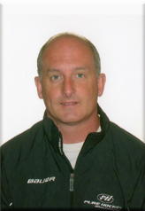
London Knights
Instructors
DAVE ROOKE Goalie Coach
In 1999, David developed PHG as the premier goaltending school in Southwestern Ontario. David`s extensive experience has enabled
him to work at every level of hockey to include the Columbus
Bluejackets (NHL), Peoria River men (AHL), and the London Knights (OHL). In 2011, David travelled to Europe to work with
teams in Switzerland. This past summer Dave was hired by the
Nashville Predators to be the Goalie Development Coach for there
AHL, ECHL and European Goalies.
Misha S. Donskov
The University of Western Ontario
Graduate School of Kinesiology
KIN 9630: Art & Science of Coaching
Dr. Bob La Rose

Slide 6
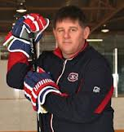
London Knights
Instructors
TIM TURK, Shooting Specialist
Tim Turk has been an NHL level skills and shooting coach since 2001. Tim works with many organizations, teams, coaches and players, male and female of all ages and levels from all over the world.
Tim Turk has recently set a record by working with 3 NHL organizations in the same Calendar year (Montreal Canadians, Tampa Bay Lightning and Carolina Hurricanes) 2012/2013.
Specializing in Shooting, Passing and Puck Control, Tim Turk Hockey also teaches the technical aspects of puck protection, puck battling, body positioning and contact.(impact and pinning) offensively and defensively.
Services include: Team Development, Camps & Clinics, Video Analysis, Private & Small Group Sessions, Game Evaluations and Tryouts.
Misha S. Donskov
The University of Western Ontario
Graduate School of Kinesiology
KIN 9630: Art & Science of Coaching
Dr. Bob La Rose

Slide 7
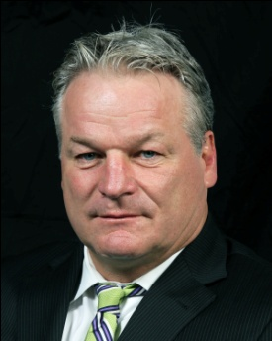
London Knights
Consultants
Dale begins his 14th season as the Owner, President and Head Coach of the London Knights. Dale has been head coach of the London Knights Hockey Club from November 2001 – November 2011. In 2011, Dale took the head coaching for the Washington Capitals of the National Hockey League but announced at the end of the season that he would be returning as head coach of the London Knights for the 2012-2013 season.
During his time with the London Knights, he has compiled a record of 431-184-23-23 in 593 games. He has the Best Winning Percentage in the history of the OHL.
Dale became the fastest coach in the history of the OHL to record 300 wins when he won his 300th game in the 1st game of the 2008-2009 season….He was named Canadian Hockey League Coach of the Year in 2003-2004 and led the London Knights to their 1st ever Memorial Cup Championship in 2004-2005 after compiling an CHL Record of 59-7-2-0 and then going 20-2-0-0 in the play-offs.
DALE HUNTER, Owner, President & Head Coach
During his time as coach of the London Knights the team has won 50 or more games 3 times and finished 1st in the OHL 4 times. Last season marked the 6th time in 9 years his team finished with 100 points or more. During his time he has worked with current NHLer’s such as Rick Nash , Corey Perry, Brandon Prust, David Bolland, Sam Gagner, and Patrick Kane. During his time with London he has also coached three 1st Overall NHL Draft Picks during their Draft Year ( Rick Nash in 2002, Patrick Kane in 2007 and John Tavares in 2009 ). Prior to purchasing the London Knights in May 2000 from the Tarry Family , Dale served as Director of Player Development for the Washington Capitals in 1999-2000. As a player Dale spent 19 seasons in the National Hockey League with the Quebec Nordiques, Washington Capitals and Colorado Avalanche. His # 32 was retired by the Washington Capitals following his career. He is a graduate of the Ontario Hockey League having played for both the Kitchener Rangers and Sudbury Wolves. In the offseason Dale enjoys horse-racing, farming and golf.
YEAR (Last 10) | CLUB | GP | W | L | T | OTL | PTS
03-04 | London | 68 | 53 | 11 | 2 | 2 | 110
04-05 | London | 68 | 59 | 7 | 2 | 0 | 120
05-06 | London | 68 | 49 | 15 | 0 | 4 | 102
06-07 | London | 68 | 50 | 14 | 0 | 4 | 104
07-08 | London | 68 | 38 | 24 | 0 | 6 | 82
08-09 | London | 68 | 49 | 16 | 0 | 3 | 101
09-10 | London | 68 | 49 | 16 | 0 | 3 | 101
10-11 | London | 68 | 34 | 29 | 0 | 5 | 73
11-12 | London | 26 | 20 | 5 | 0 | 1 | 41
11-12 | Washington | 60 | 30 | 23 | 0 | 7 | 67
12-13 | London | 68 | 50 | 13 | 2 | 3 | 105
 | Career Totals | 756 | 501 | 202 | 19 | 34 | 1055
 | Win% | .675

Slide 8
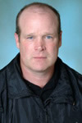
London Knights
Consultants
MARK HUNTER, Owner/Vice President & General Manager
Mark begins his 14th season as Owner/Vice President and General Manager of the London Knights Hockey Club. In November 2011 Mark assumed the role Head Coach leading the London Knights to an OHL Championship and Memorial Cup final with a 29-13-0 record in the regular season. During his 11 season’s as General Manager , the Hockey Club has turned into the one of the most successful organizations, both on and off the ice, in the history of the Ontario Hockey League. Under Mark’s direction the team’s season ticket holder base has grown to a present number of 7,200 up from 1, 261 when the team was first purchased in May 2000.
The team has sold out hundreds of games at the John Labatt Centre and continues to lead the OHL in attendance each of the last 6 seasons. The team also hosted multiple high status tournaments including the 2003 Canada Russia Challenge and the 2004 CHL Prospects Game. Mark was named Canadian Hockey League Executive of the Year in 2003 for his outstanding efforts and continues to remain a member of the OHL Competitions Committee playing a key role in providing feedback for rules, style of play, officiating and off-ice seminars. During his tenure running the Hockey Operations of the London Knights he has had 3 of his players drafted 1st Overall in NHL Drafts with Rick Nash ( 1st Overall , 2002 ) , Patrick Kane ( 1st Overal, 2007 ) and John Tavares ( 1st Overall, 2009 ). Mark is also responsible for building the on ice team, and was the architect of the 2004-2005 Memorial Cup Champion London Knights who broke a CHL Record of 30 years with 31 games unbeaten to open the season. The 2004-2005 team set 13 CHL Records and finished the season with an amazing record of 79-9-2-0 which was culminated with a 4-0 triumph over Sidney Crosby and the Rimouski Oceanic in the Memorial Cup Final. During his time with the Knights, Mark has served on many committees in London and was responsible for the creation of the London Knights Charitable Foundation. During his tenure overseeing this foundation, the London Knights have donated approximately one million dollars to local charities. Mark and his brother Dale were also the Platinum Sponsors of the 2010 Special Olympics and pledged $ 100,000 to fund the games.
Prior to purchasing the London Knights, Mark played 12 seasons in the National Hockey League and was the 1st Round Selection of the Montreal Canadiens at the 1981 NHL Draft. He was a member of the 1989 Stanley Cup Champion Calgary Flames and is no stranger to being part of the OHL as he was the 1st Overall Selection at the 1979 OHL Draft by the Brantford Alexanders. He and his wife Linda along with their 4 children reside in Oil Springs, Ontario. In the off season Mark enjoys farming and golfing.
Misha S. Donskov
The University of Western Ontario
Graduate School of Kinesiology
KIN 9630: Art & Science of Coaching
Dr. Bob La Rose

